Slide 1

E-Commerce Website
“Your Project Name”
Task - 3

Slide 2

E-commerce Website
Introduction : E-Commerce, also known as electronic commerce or internet commerce, is an activity of buying and selling goods or services over the internet or open networks.
LMS Username | Name | Batch
HariPrasad R | R. Hari Prasad | NM_0.2 CC3
Snega E | E. Snega | NM_0.2 CC3
Apsara devi T | T. Apsara devi | NM_0.2 CC3
Logeshwari R | R. Logeshwari | NM_0.2 CC3

Slide 3
Task 3 :: Frontend Creation
Create various Front End Programs
We have designed a frontend program using React.js
Evaluation Metric:
100% Completion of the above tasks
Learning outcome
Developing complicated UI using React components
Using props drilling and context to pass variables
Getting familiar with different type of api calls
Handling different input data

Slide 4

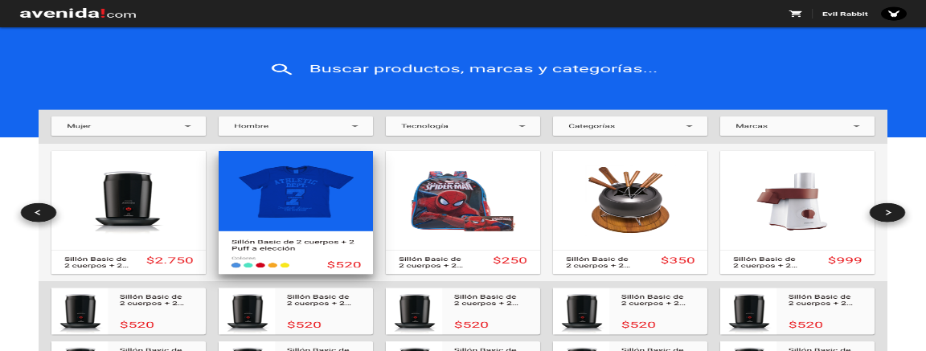
Step-Wise Description
We have designed a frontend program using React.js
Using react components
Connections for backend using API call
Summary of your task
Using react components, we have succeeded to build a frontend program and it works perfectly

Slide 5
Assessment Parameter
Create folder structure for React application
Render Conditional components
Write Functions for event handling
Check-List
Overall UI of the project
Use props to pass variables
Handling broken links
Use ApI calls for data
Optimizing render cycle

Slide 6
Submission Github
logesh1911/Naan_Mudhalvan(github.com)
https://github.com/Apsara1401/Naan_Mudhalvan
https://github.com/Snegaasai/Naan-Mudhalvan
https://github.com/hprs0310/ecommerce

